Slide 1
APP STORE
Presented by
Chidvilas Tammireddy

Slide 2
Contents
Data Model
Login
Categories
Applications
Downloads
Manage Applications
Stored Procedures
Encryption Decryption of Password in SQL SERVER
Triggers
Views
Sequences
Indexes
SSIS Package to import data to the database
Future Scope

Slide 3
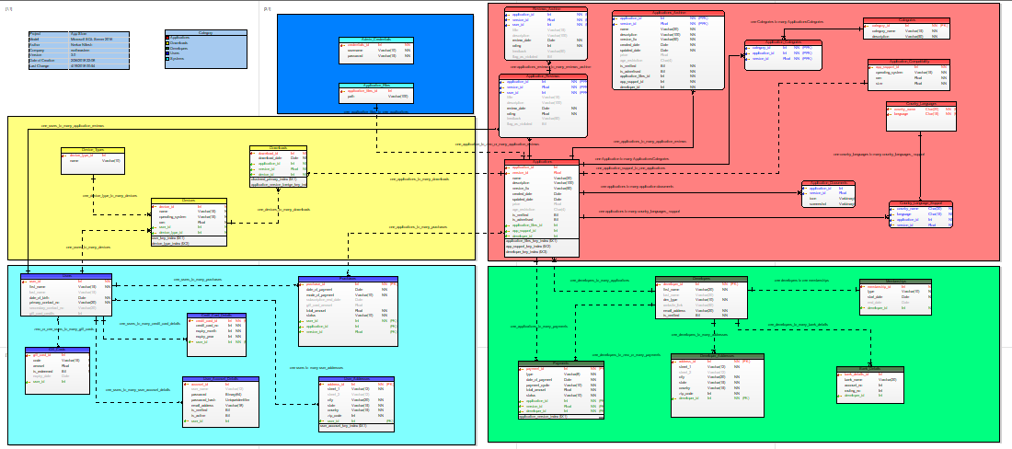
Data MODEL

Slide 4

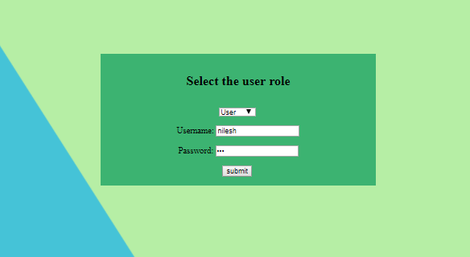
Login
The project in created using PHP and SQL Server
Login functionality has two roles: Users and Admin
Users can view the applications category wise and download it
Admin can add new applications; view, update and delete all the versions of an application

Slide 5
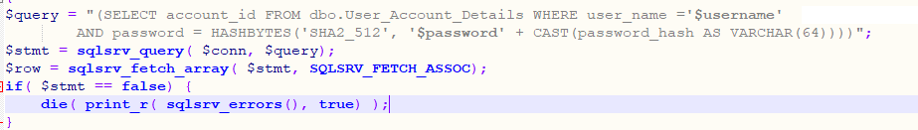
Login
The password is stored in encrypted form and hence has to decrypt and validate the user while login
The snippet shows the decryption used to validate the user in PHP LOGIN form
The encryption and decryption of the password can be seen in the following slides under STORED PROCEDURES

Slide 6
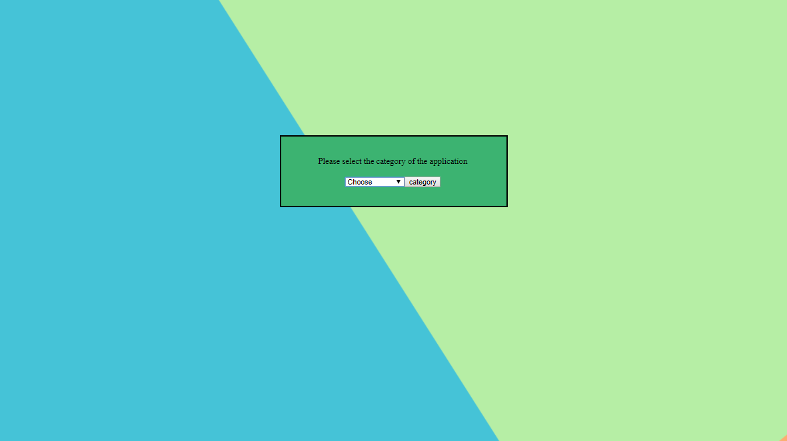



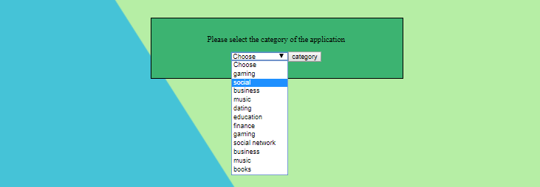

Categories
Users can select one category at a time and proceed

Slide 7
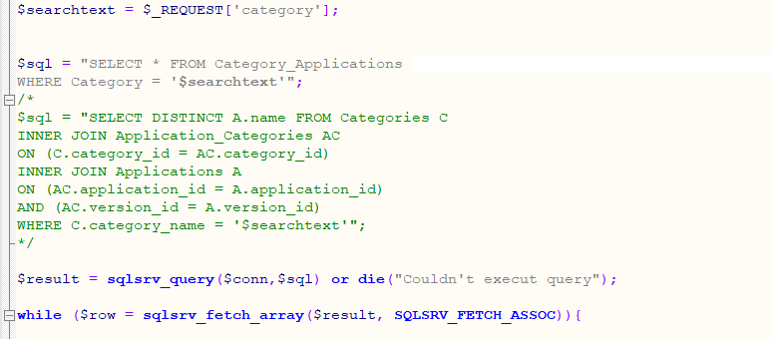
Categories
To display rating based on category and a particular application, I had to join five tables and hence I created a view instead
View increases the query performance
The snippet shows the usage of view in my PHP project
So instead of using a big join query I used Category_Applications View
The view SQL code can be seen in following slide under VIEWS

Slide 8
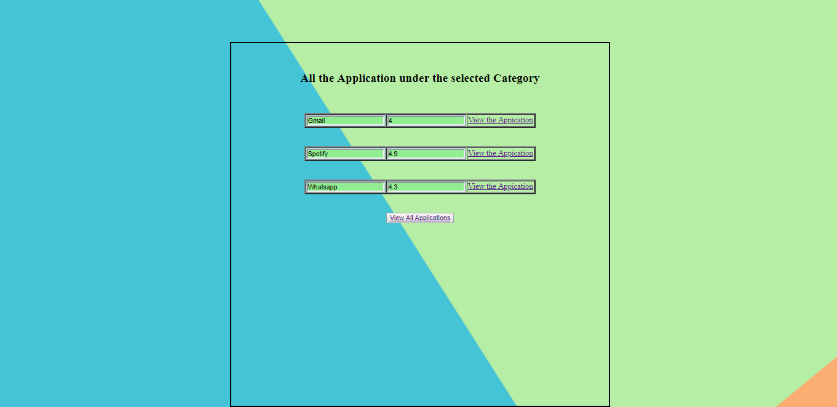
Applications
User can view applications and their ratings
User can view all application or a particular application in the next window by clicking view all applications button

Slide 9
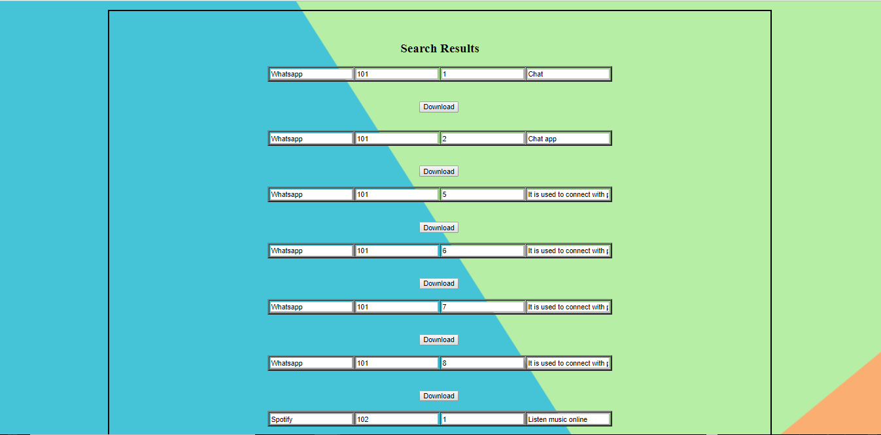
Applications
All the applications along with their ratings can be seen here

Slide 10
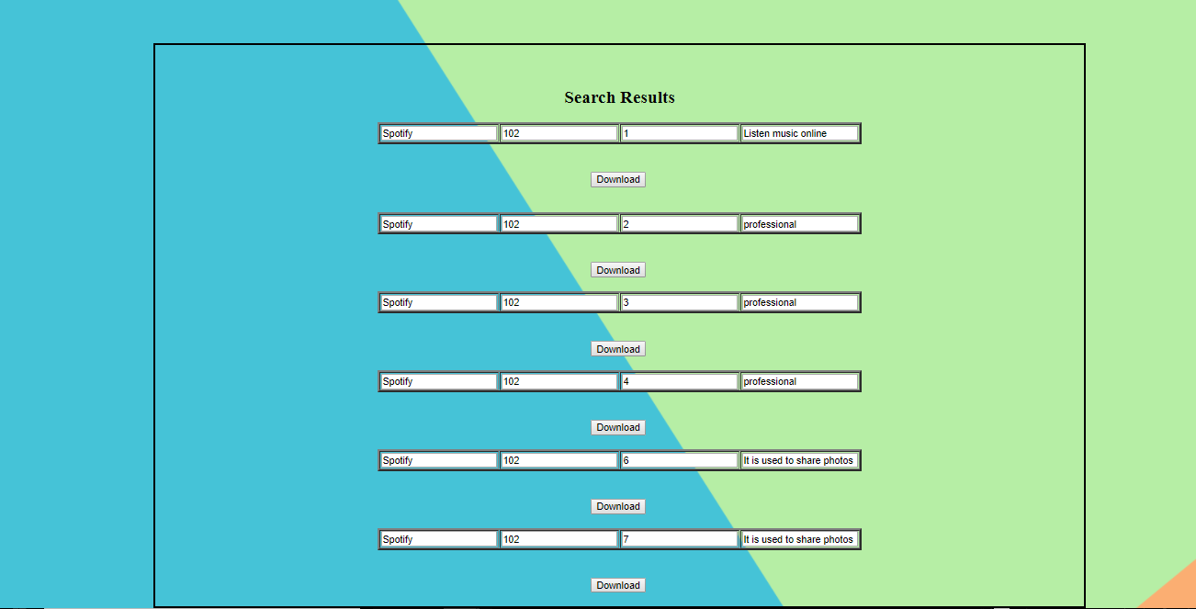
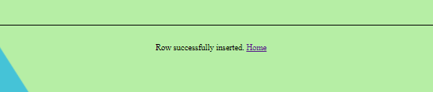
Downloads
User can view all the version of a particular application as well
User can download an application by clicking download button
Row successfully inserted shows the download success

Slide 11
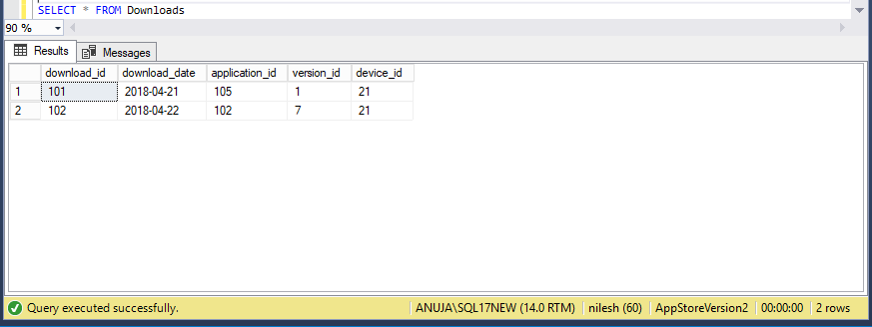
Downloads
Downloads table after download of the application

Slide 12
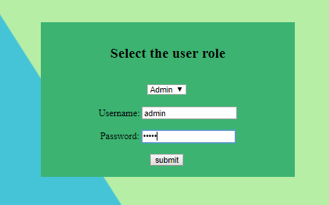
Manage Applications
Admin can add a new application, search for a particular application
Admin can update the name of an application
Admin can delete an application
Th snippet shows the admin login

Slide 13

Manage Applications
Admin clicks on view applications and goes to manage applications window

Slide 14
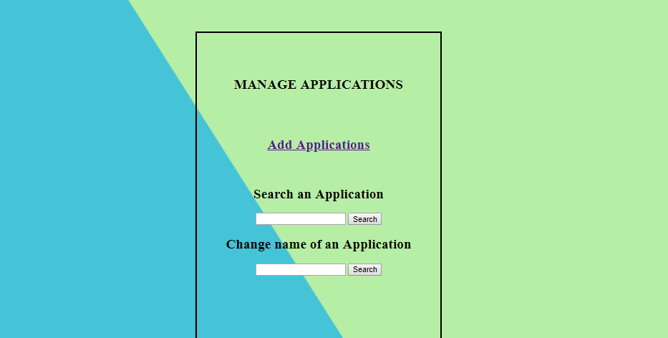
Manage Applications
Admin clicks on view applications and goes to manage applications window
Admin can add a new application on click of Add_Applications link

Slide 15
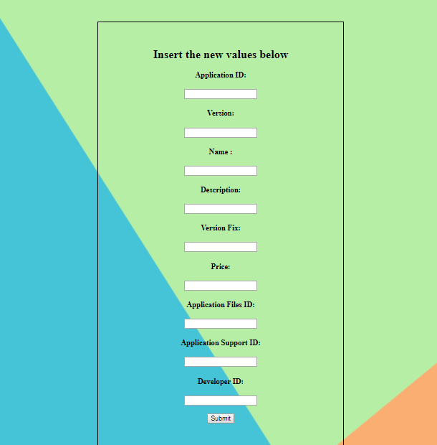
Manage Applications
Admin on click of add application comes to this window where he or she can insert values for an application

Slide 16
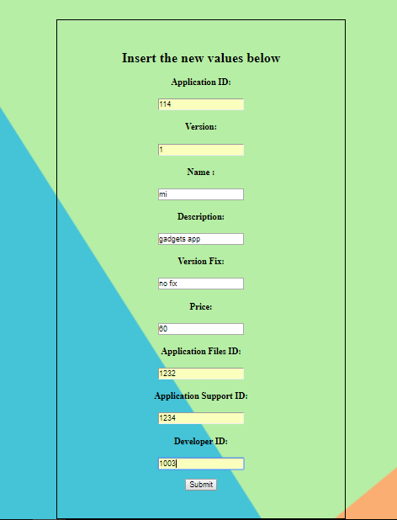
Manage Applications
Admin enters the data for insertion

Slide 17
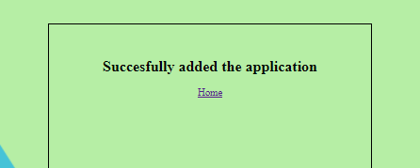
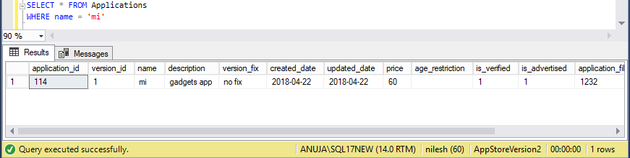
Manage Applications
Insert success notification after successful addition of a new application to the table
The snippet shows the application MI created

Slide 18


Manage Applications
Admin on click of search button comes to this window
Admin can delete the application by name and the message is displayed

Slide 19
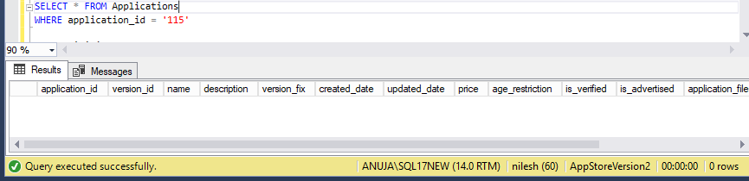
Manage Applications
The application has been successfully deleted
There is no application with application_id 115 in the Applications table

Slide 20
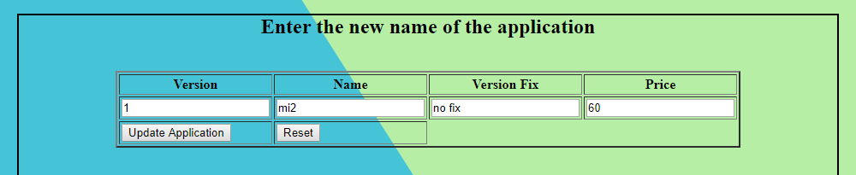
Manage Applications
Admin on click of search button to update the name comes to this window
Admin update the name and the message is displayed

Slide 21
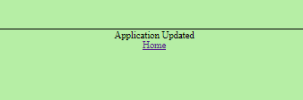
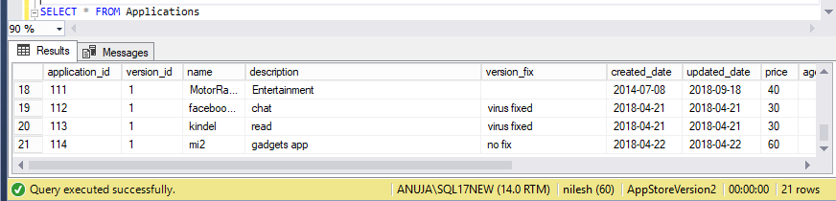
Manage Applications
The application has been successfully updated
After update the snippet for the changed name of the application from mi to mi1

Slide 22
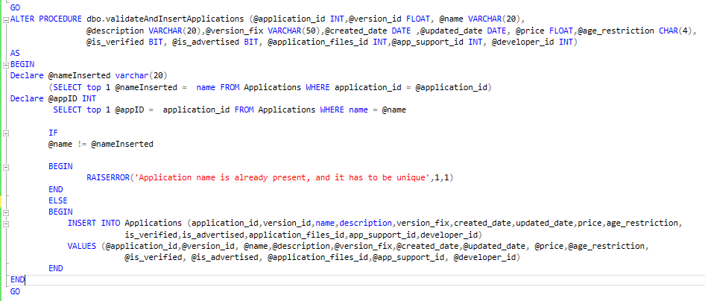
Stored Procedures
Stored Procedure to insert and validate the application name
Since my model does not have unique constraint on the application name I had to create a procedure to check the uniqueness of the name with respect to the application_id

Slide 23
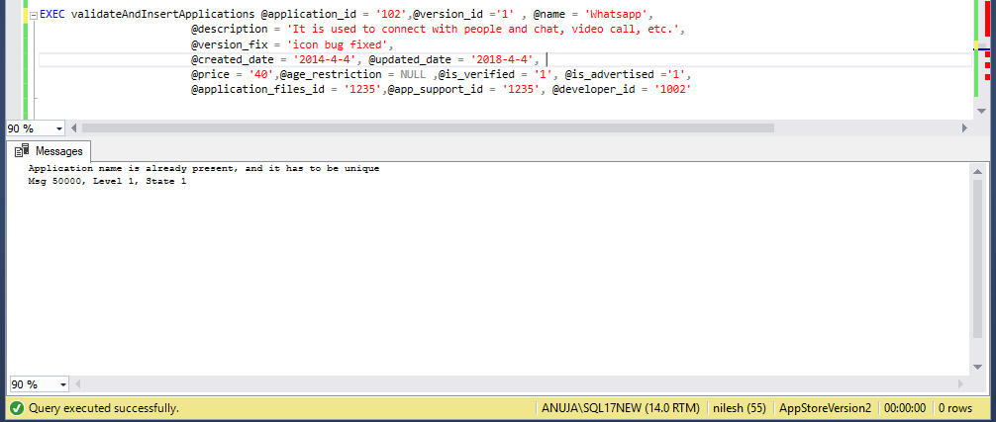
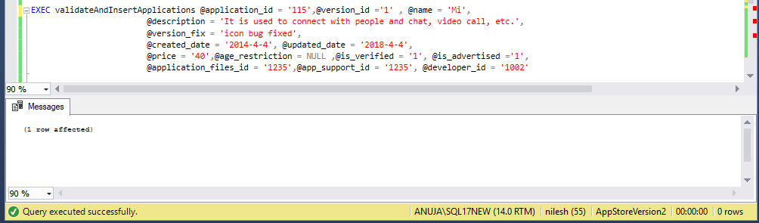
Stored Procedures
Execution of the SP for insertion of values
The snippet shows an incorrect entry and a correct entry of the application name

Slide 24
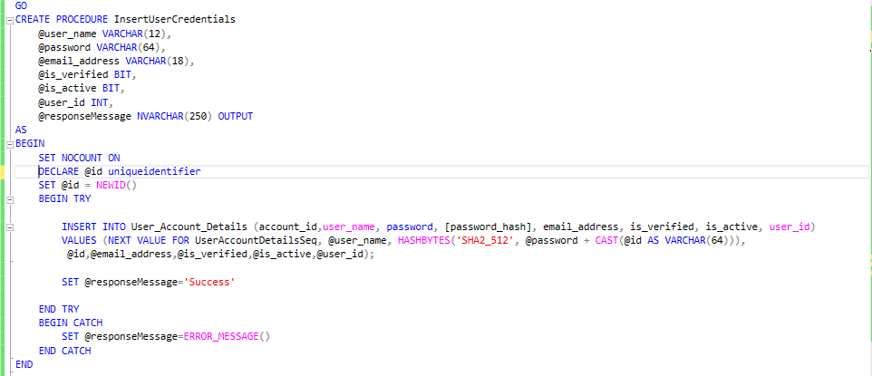
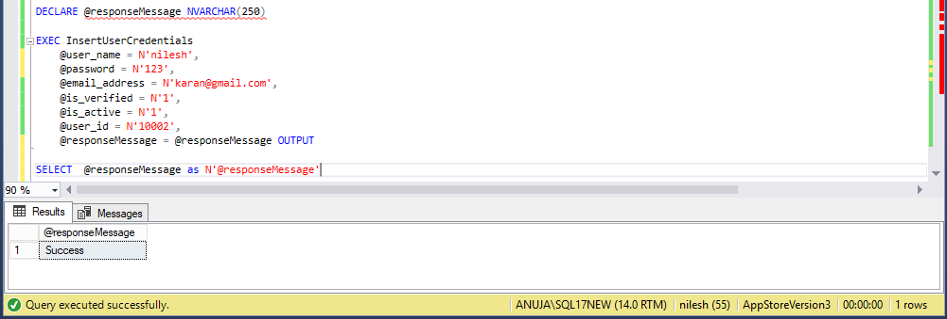
Encryption Decryption of Password in SQL SERVER
SP for inserting password and encrypt it
The password is inserted and stored in binary form
Before inserting a has is created using HASHBYTES function
It adds the inserted password with a new uniqueidentifier value

Slide 25
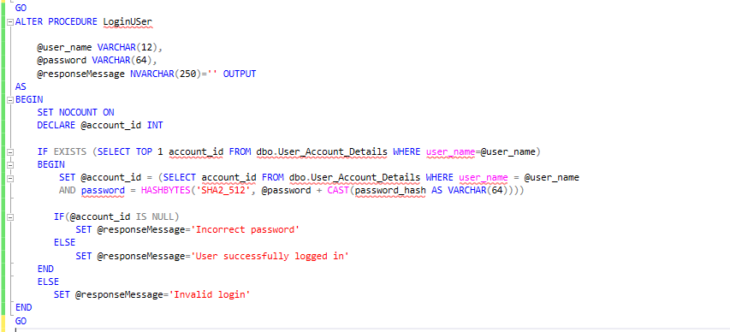
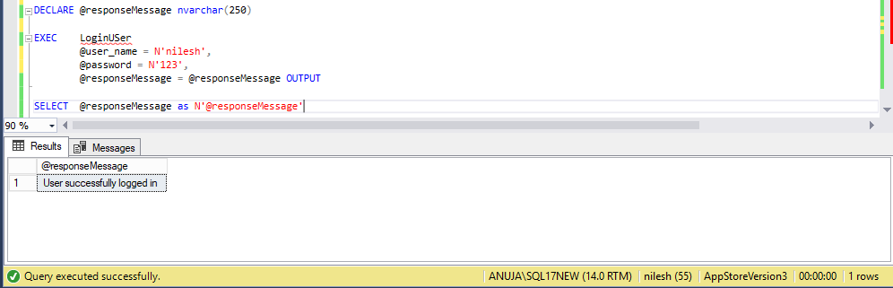
Encryption Decryption of Password in SQL SERVER
SP for decrypting the password and validate the user
The reverse is done in this procedure to decrypt the password

Slide 26
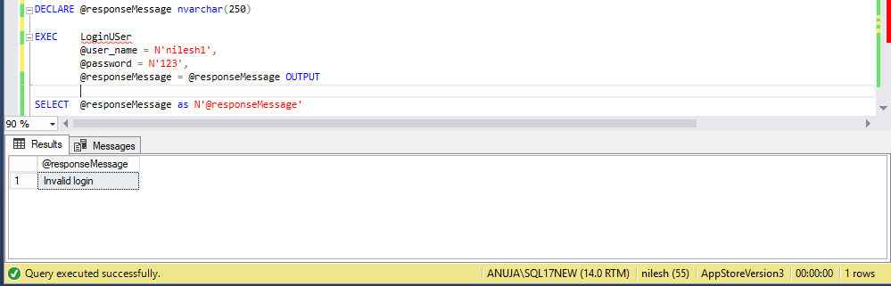
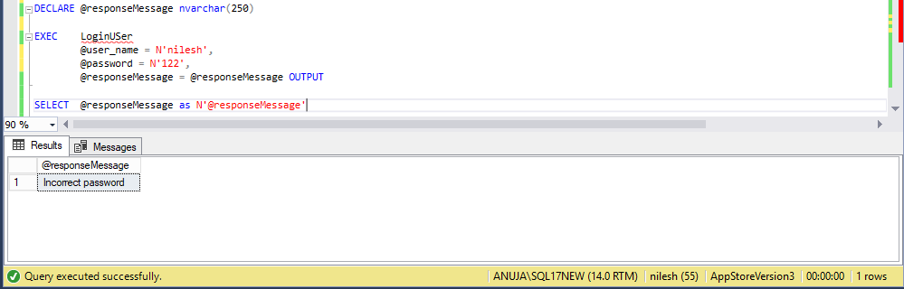
Encryption Decryption of Password in SQL SERVER
When the credentials are incorrect

Slide 27
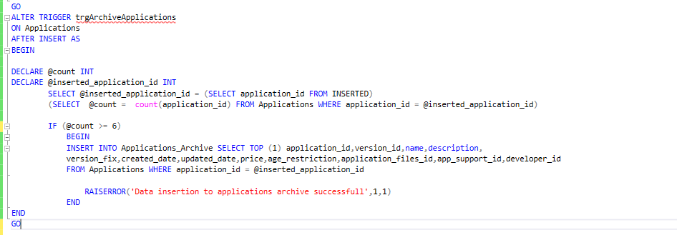
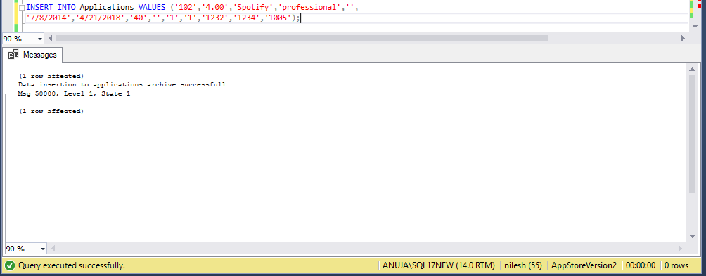
TRIGGERS
Trigger to backup applications after the 6th version is entered in the application for a particular app
The backup is taken into Applications Archive Table

Slide 28
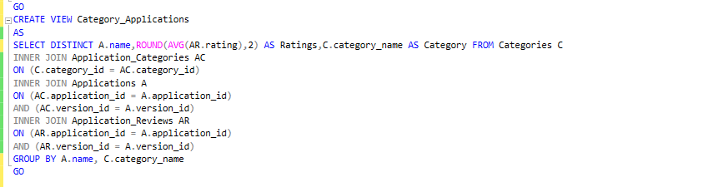
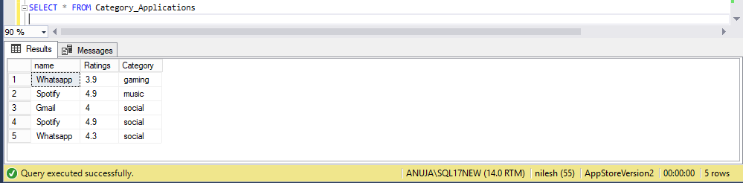
VIEWS
Created a VIEW as we need to the RATING of application to be the average of all
Category also needed so that users can choose the category they like
Instead of querying many table, created a view which is used to in the application using PHP

Slide 29
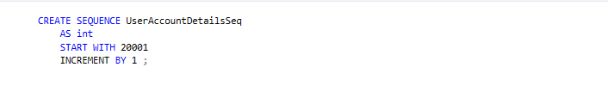
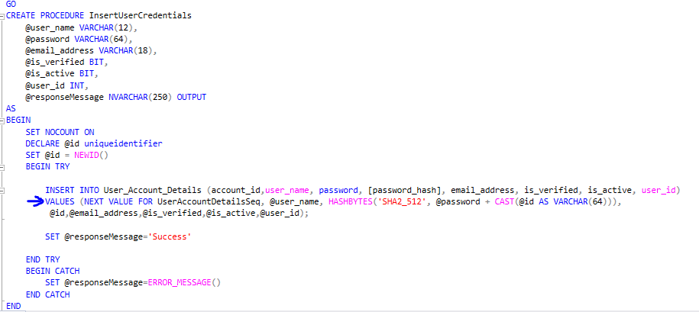
SEQUENCES
Created sequences on many tables to auto increment the primary keys after INSERT
UserAccountDetailsSeq sequence created is used for inserting values through SP

Slide 30
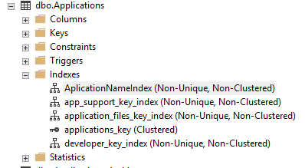
INDEXES
Using Toad Modeler Indexes are created easily; however you can create an index manually
Have created many non-clustered indexes on column which are used often
The retrieval of the data is faster and query performance increases by using indexes

Slide 31
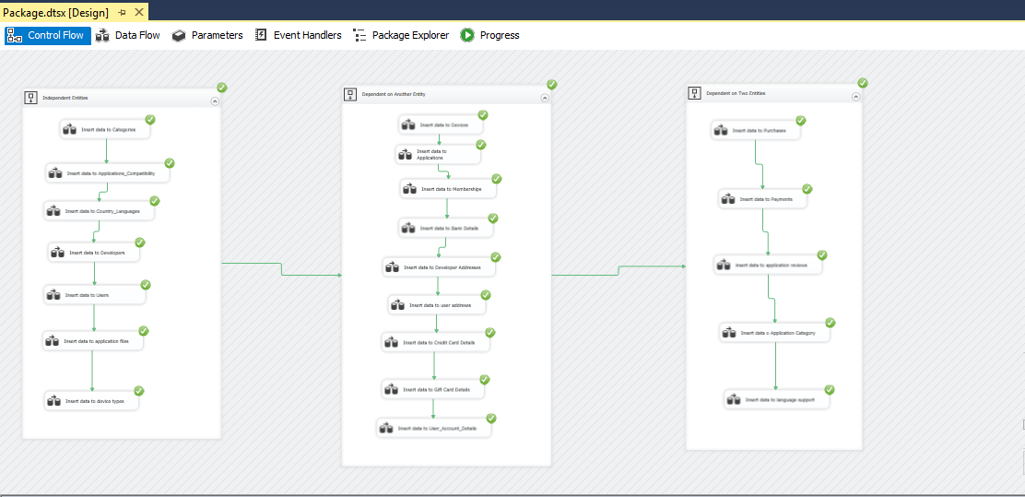
SSIS Package
Created a SSIS package which loads data from excel to the data base using sequence container
The first container loads independent tables
The second loads dependent tables
The third container loads remaining tables and bridge tables

Slide 32
FUTURE SCOPE
Application database can be backed up using a stored procedure
Insertion using sequence can be added, for that the table has to be dropped and create again
An identity has to set on primary key
Application’s image can be displayed
Number of downloads can displayed
Invoice can be generated

